Slide 1
Sets

Slide 2
Problem:
An University has published the results of the term end examination conducted in April. List of failures in physics, mathematics, chemistry and computer science is available. Write a program to find the number of failures in the examination. This includes the count of failures in one or more subjects

Slide 3
PAC For University Result Problem
Input | Processing | Output
Read the register number of failures in Maths, Physics, Chemistry and Computer Science | Create a list of register numbers who have failed in one or more subjects Count the count of failures | Print Count

Slide 4
Pseudocode
READ maths_failure, physics_failure, chemistry_failure and cs_failure
Let failure be empty
FOR each item in maths_failure
ADD item to failure
FOR each item in physics_failure
IF item is not in failure THEN
ADD item to failure
END IF
FOR each item in chemistry_failure
IF item is not in failure THEN
ADD item to failure
END IF
FOR each item in cs_failure
IF item is not in failure THEN
ADD item to failure
END IF
SET count = 0
FOR each item in failure
count = count + 1
PRINT count

Slide 5
Sets
an unordered collection of unique and immutable objects that supports operations corresponding to mathematical set theory
Set is mutable
No duplicates
Sets are iterable, can grow and shrink on demand, and may contain a variety of object types
Does not support indexing

Slide 6
x = {1, 2, 3, 4}
y = {'apple','ball','cat'}
x1 = set('spam') # Prepare set from a string
print (x1)
{'s', 'a', 'p', 'm'}
x1.add('alot') # Add an element to the set
print (x1)
{'s', 'a', 'p', 'alot', 'm'}

Slide 7
Set Operations
Let S1 = {1, 2, 3, 4}
Union (|)
S2 = {1, 5, 3, 6} | S1
print(S2) # prints {1, 2, 3, 4, 5, 6}
Intersection (&)
S2 = S1 & {1, 3}
print(S2) # prints {1, 3}

Slide 8
Difference (-)
S2 = S1 - {1, 3, 4}
print(S2) # prints {2}
Super set (>)
S2 = S1 > {1, 3}
print(S2) # prints True
Empty sets must be created with the set built-in, and print the same way

Slide 9
S2 = S1 - {1, 2, 3, 4}
print(S2) # prints set() – Empty set
Empty curly braces represent empty dictionary but not set
In interactive mode – type({}) gives
<class 'dict'>

Slide 10
>>> {1, 2, 3} | {3, 4}
{1, 2, 3, 4}
>>> {1, 2, 3} | [3, 4]
TypeError: unsupported operand type(s) for |: 'set' and 'list'
>>> {1, 2, 3} | set([3, 4]) #Convert list to set and work
{1,2,3,4}

Slide 11
>>> {1, 2, 3}.union([3, 4]) #if you use union it will not give you the error
{1,2,3,4}
>>> {1, 2, 3}.union({3, 4})
{1,2,3,4}

Slide 12
Immutable constraints and frozen sets
Can only contain immutable (a.k.a. “hashable”) object types
lists and dictionaries cannot be embedded in sets, but tuples can if you need to store compound values.
Tuples compare by their full values when used in set operations:
>>> S
{1.23}
>>> S.add([1, 2, 3])
TypeError: unhashable type: 'list'

Slide 13
>>> S.add({'a':1})
TypeError: unhashable type: 'dict'
Works for tuples:
>>> S.add((1, 2, 3))
>>> S
{1.23, (1, 2, 3)}

Slide 14
>>> S | {(4, 5, 6), (1, 2, 3)}
{1.23, (4, 5, 6), (1, 2, 3)}
>>> (1, 2, 3) in S # Check for tuple as a whole
True
>>> (1, 4, 3) in S
False

Slide 15
clear()
All elements will removed from a set.
>>> cities = {"Stuttgart", "Konstanz", "Freiburg"}
>>> cities.clear()
>>> cities
set() # empty
>>>

Slide 16
Copy
Creates a shallow copy, which is returned.
>>> more_cities = {"Winterthur","Schaffhausen","St. Gallen"}
>>> cities_backup = more_cities.copy()
>>> more_cities.clear()
>>> cities_backup # copied value is still available
{'St. Gallen', 'Winterthur', 'Schaffhausen‘}

Slide 17
Just in case, you might think, an assignment might be enough:
>>> more_cities = {"Winterthur","Schaffhausen","St. Gallen"}
>>> cities_backup = more_cities #creates alias name
>>> more_cities.clear()
>>> cities_backup
set()
>>>
The assignment "cities_backup = more_cities" just creates a pointer, i.e. another name, to the same data structure.

Slide 18
difference_update()
removes all elements of another set from this set. x.difference_update() is the same as "x = x - y"
>>> x = {"a","b","c","d","e"}
>>> y = {"b","c"}
>>> x.difference_update(y)
>>> x
{'a', 'e', 'd'}

Slide 19
discard(el)
el will be removed from the set, if it is contained in the set and nothing will be done otherwise
>>> x = {"a","b","c","d","e"}
>>> x.discard("a")
>>> x
{'c', 'b', 'e', 'd'}
>>> x.discard("z")
>>> x
{'c', 'b', 'e', 'd'}

Slide 20
remove(el)
works like discard(), but if el is not a member of the set, a KeyError will be raised.
>>> x = {"a","b","c","d","e"}
>>> x.remove("a")
>>> x
{'c', 'b', 'e', 'd'}
>>> x.remove("z")
Traceback (most recent call last):
File "<stdin>", line 1, in <module>
KeyError: 'z’

Slide 21
isdisjoint()
This method returns True if two sets have a null intersection
issubset()
x.issubset(y) returns True, if x is a subset of y
"<=" is an abbreviation for "Subset of" and ">=" for "superset of"
"<" is used to check if a set is a proper subset of a set
Notes:
A proper subset of a set A is a subset of A that is not equal to A.

Slide 22
issuperset()
x.issuperset(y) returns True, if x is a superset of y. ">=" - abbreviation for "issuperset of“
">" - to check if a set is a proper superset of a set

Slide 23
>>> x = {"a","b","c","d","e"}
>>> y = {"c","d"}
>>> x.issuperset(y)
True

Slide 24
>>> x > y
True
>>> x >= y
True
>>> x >= x
True
>>> x > x
False
>>> x.issuperset(x)
True

Slide 25
>>> x = {"a","b","c","d","e"}
>>> y = {"c","d"}
>>> x.issubset(y)
False
>>> y.issubset(x)
True

Slide 26
>>> x < y
False
>>> y < x # y is a proper subset of x
True
>>> x < x # a set is not a proper subset of oneself.
False
>>> x <= x
True

Slide 27
pop()
pop() removes and returns an arbitrary set element.
The method raises a KeyError if the set is empty
>>> x = {"a","b","c","d","e"}
>>> x.pop()
'a'
>>> x.pop()
'c'

Slide 28
Sets themselves are mutable too, and so cannot be nested in other sets directly;
if you need to store a set inside another set, the frozenset built-in call works just like set but creates an immutable set that cannot change and thus can
be embedded in other sets

Slide 29
To create frozenset:
cities = frozenset(["Frankfurt", "Basel","Freiburg"])
cities.add("Strasbourg") #cannot modify
Traceback (most recent call last):
File "<stdin>", line 1, in <module>
AttributeError: 'frozenset' object has no attribute 'add'

Slide 30
Set comprehensions
run a loop and collect the result of an expression on each iteration
result is a new set you create by running the code, with all the normal set behavior
>>> {x ** 2 for x in [1, 2, 3, 4]}
{16, 1, 4, 9}
>>> {x for x in 'spam'}
{'m', 's', 'p', 'a'}

Slide 31
>>> S = {c * 4 for c in 'spam'}
>>> print(S)
{'pppp','aaaa','ssss', 'mmmm'}
>>>> S = {c * 4 for c in 'spamham'}
{'pppp','aaaa','ssss', 'mmmm','hhhh'}
>>>S | {'mmmm', 'xxxx'}
{'pppp', 'xxxx', 'mmmm', 'aaaa', 'ssss'}
>>> S & {'mmmm', 'xxxx'}
{'mmmm'}

Slide 32
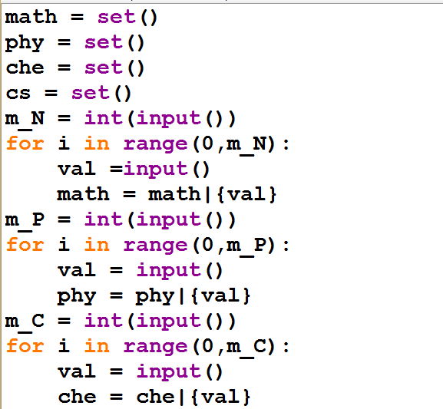
Notes:
math=set()
phy=set()
che=set()
cs=set()
m_M=int(input()) #Number of student failed in maths
for i in range(0,m_M):
val=input()
math=math|{val}
m_p=int(input()) #Number of student failed in physics
for i in range(0,m_p):
val=input()
phy=phy|{val}
m_c=int(input()) #Number of student failed in chemistry
for i in range(0,m_c):
val=input()
che=che|{val}
m_cs=int(input()) #Number of student failed in computer science
for i in range(0,m_cs):
val=input()
cs=cs|{val}
failure=math|phy|che|cs
print(len(failure))

Slide 33
